Slide 1



Mission in Printerbales: Harnessing the Power of Customer Data Analytics
Team: Beauty and the Beasts

Slide 2
Outline
Background & Business Questions
Analysis
Data Exploration
User Segmentation
Repurchase Propensity Prediction
Recommendation Summary & Conclusions

Slide 3

HP at a Glance
24.5%
3
Industry Leader
Market Share
Business Areas
Notes:
HP holds 24.5% of the printer product industry market share based on printer shipments in 2021. They are the industry leader and are among the leaders in many of their key business segments.
HP has three reporting areas: Personal System (60-70%), Printing (30-40%), and Corporate Investment.
HP operates in a moderately fragmented market. None of the companies dominates the market, making the industry highly competitive.
Canon
Lexmark International
Xerox
Epson
Richo
Brother
Independent suppliers (offer non-original supplies)

Slide 4

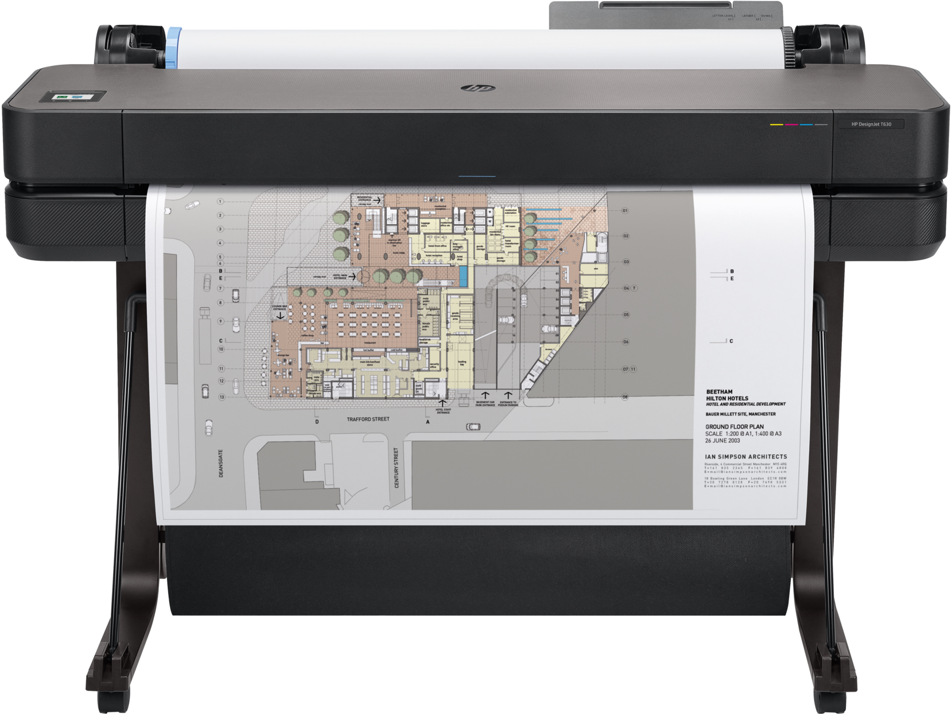
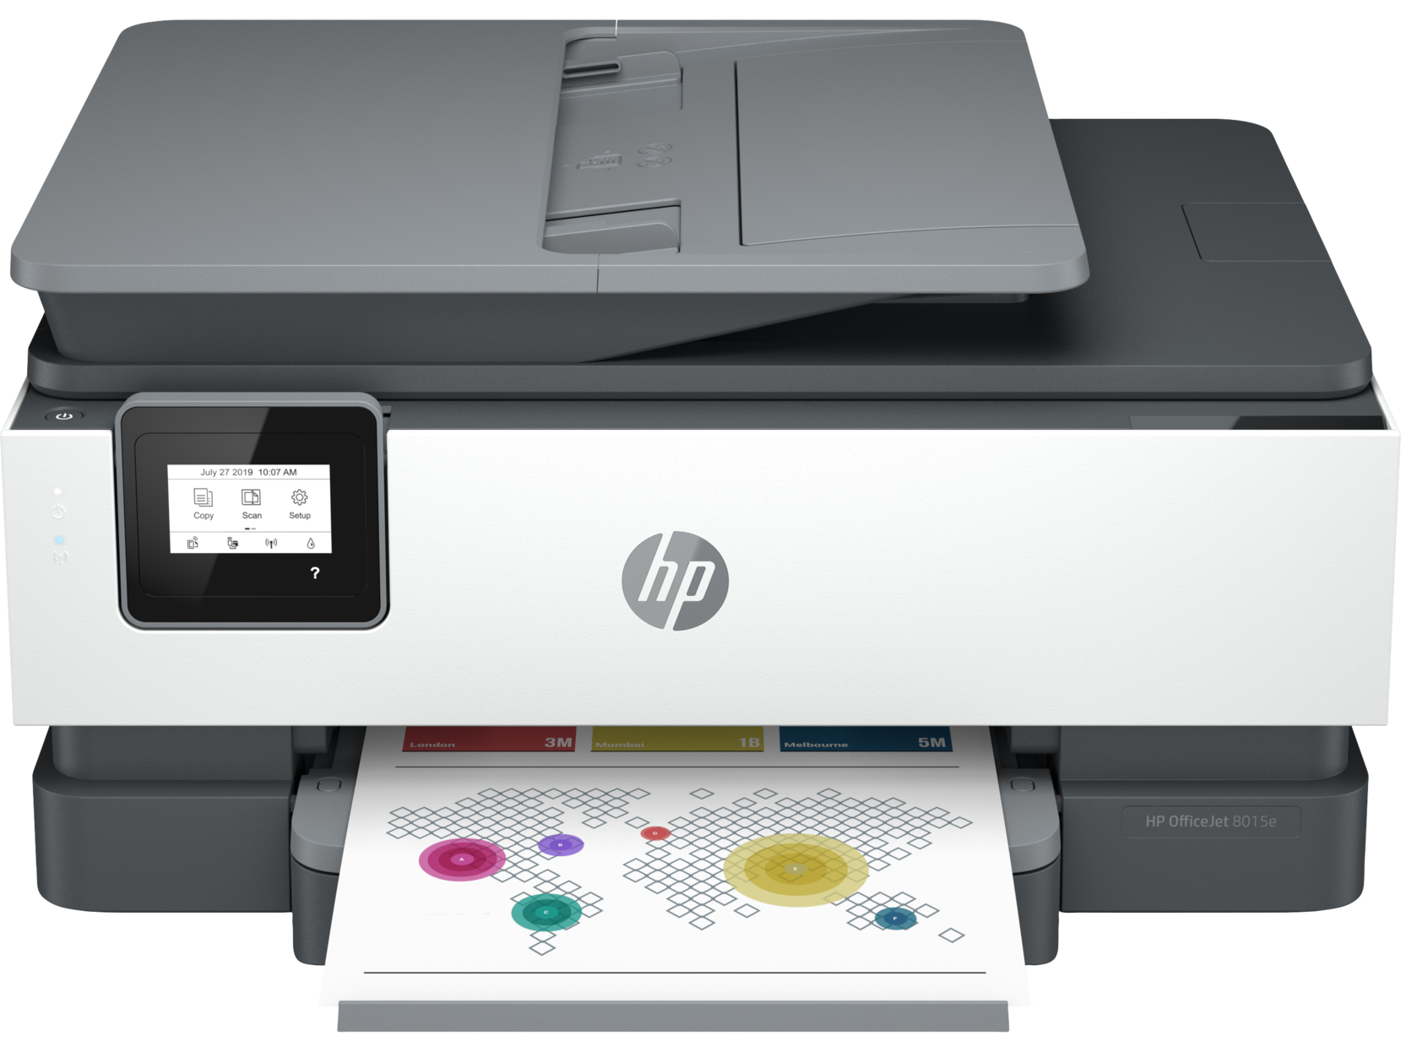
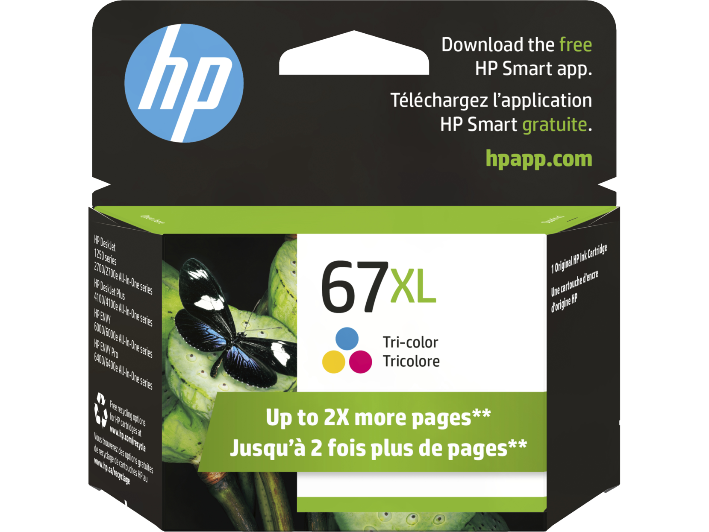
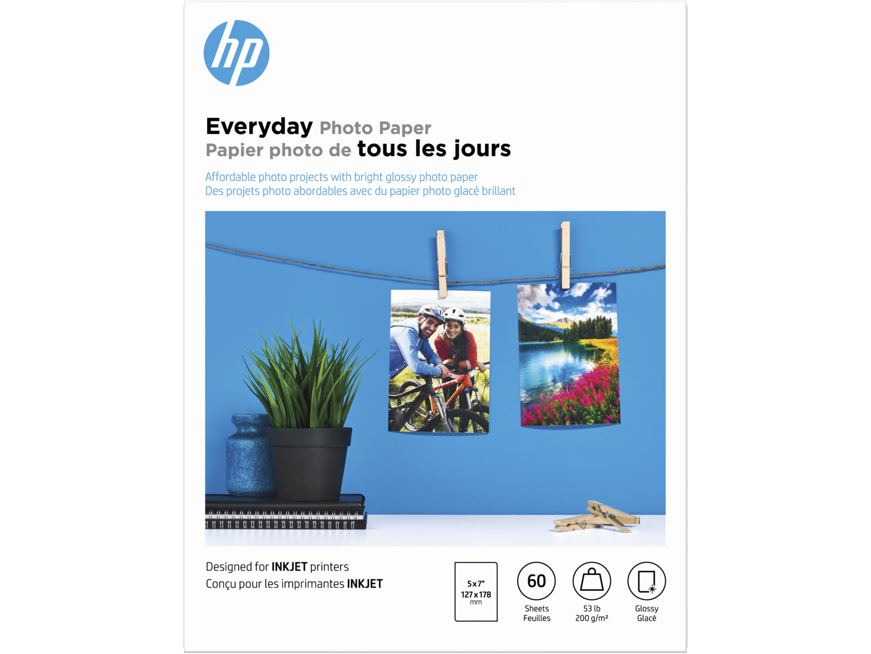
HP at a Glance
Commercial
Consumer
Supplies
Notes:
In the Printing area, HP’s business capabilities include Home Printing Solutions, Office Printing Solutions, Graphics Solutions, and 3D Printing and Digital Manufacturing.
HP groups its printing business capabilities into the following three business units: Commercial, Consumer, and Supplies.

Slide 5
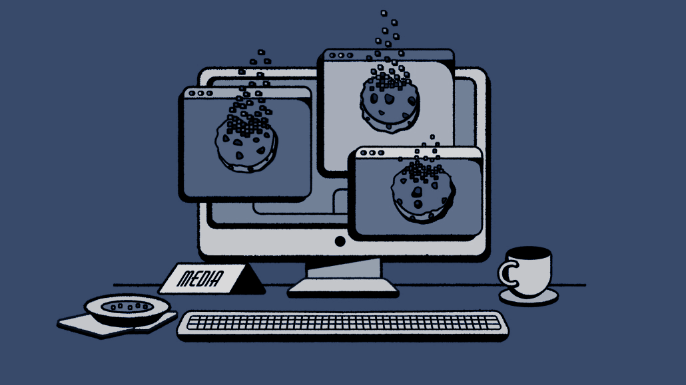
Challenge: A Cookie-less World
How could HP renew its focus on
first-party data in Marketing?
Notes:
In January 2020, Google announced that it would remove 3rd party cookies from Chrome. Many companies including HP use third party data from cookies to drive customer marketing initiatives. This is a significant change to the source of HP’s successful customer segmentation. Without sufficient and detailed customer data, HP could lose out on maintaining its growing customer base and, consequently, its edge in the market.
As a result, HP has to adapt in a cookie-less future. The company has chosen to leverage its first-party data gathered over the years.
"In this cookie-less world, how can HP shift its focus to leveraging first-party data for marketing and revenue generation?"

Slide 6
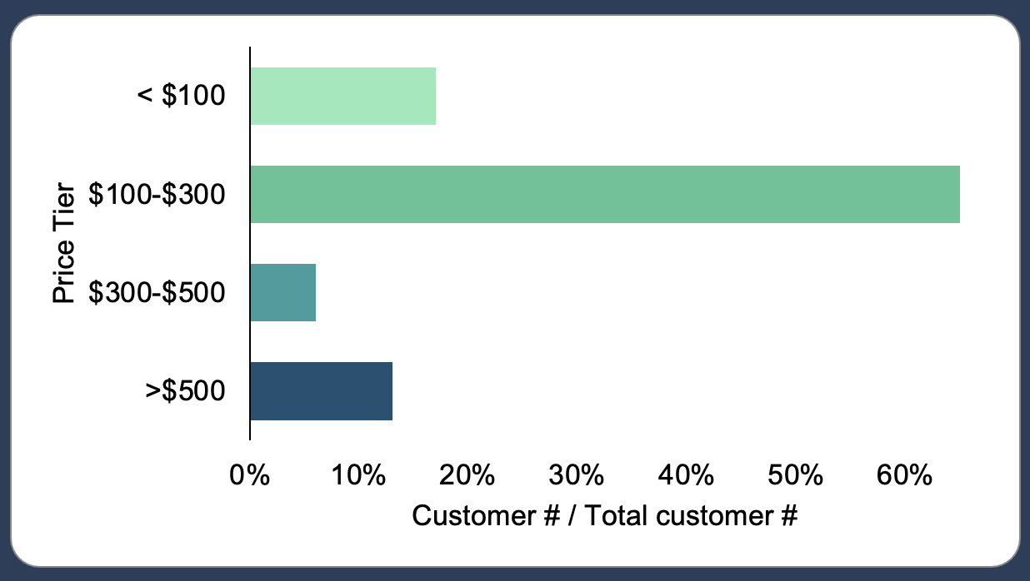
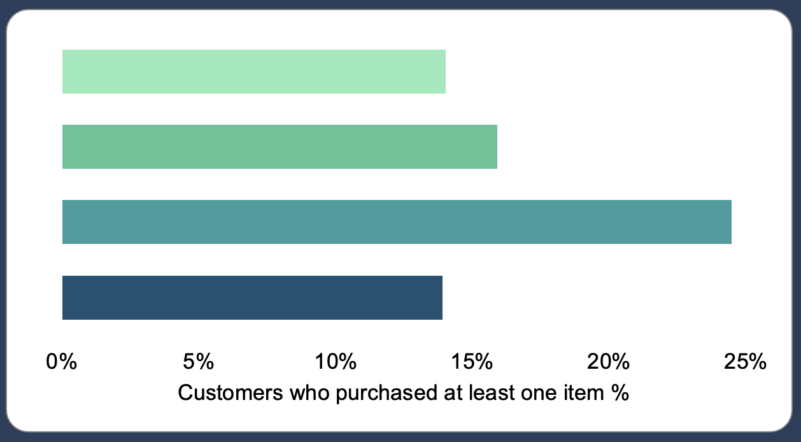
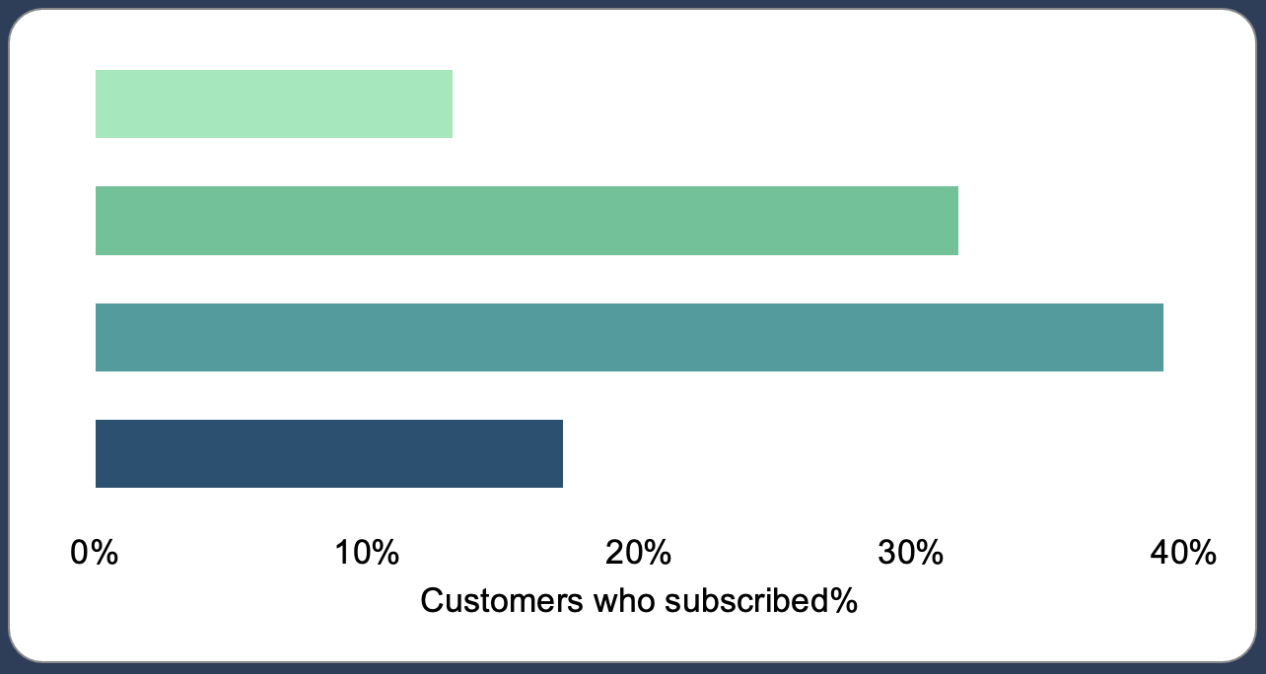
Revenue
= Avg. Price Per Purchase x Repurchase Frequency
Customer Distribution by Price Tier
Repurchase% of Each Price Tier
Subscribed% of Each Price Tier
Higher: ‘$100-300’
Lower: ‘$300-500’ or ‘>$500’
Higher: ‘$300-500’ or ‘>$500’
Lower: ‘$100-300’
Higher in # Customers,
Lower in Repurchase and Subscription%
Notes:
How to drive revenue? Revenue = Average price per purchase x Repurchase Frequency.
Let’s look at the Customers and start from their purchasing price first.
Graph 1:
This plot shows customer distribution across different product price tiers.
The x-axis is the number of customers who purchased products within this price tier, divided by Total Customer.
=> Findings: The largest proportion of customers purchased products within the price range of $100 to $300, the lowest is $300-500.
Graph 2 & 3:
Then, we go deeper, to see within each price tier, What proportion of customers made at least one purchase? & What percentage of customers are subscribed to instant ink?
The x-axis are customers who purchased at least one team/total customers in that group, and customers who subscribed/total customers in that group, respectively.
=> Findings:
1） Percentages of customers who made more than one purchase are below 25%, not even each 30%; percentages of subscribers are below 40%, less than 50%. That it, More than half of the people who bought HP printers did not subscribe to Instant Ink;
2） Even though the $100-300 price range represents the largest customer group, their repurchase and subscription rates are not very high, indicating room for incremental revenue growth;
3) On the other hand, although the proportions of customers who purchased products in the $300-500 and over $500 price range are relatively low, their purchase and subscription rates are relatively high (top2), indicating a higher potential long-term value.
===>
If the company could convert $100-300 to $300-500 or $500 price tier,
then the company could make more revenue per customer, with larger likely of higher number of repurchased and strong long-term subscription relation (larger potential value).

Slide 7
Three Directions to Increase Revenue
Convert to
Higher Price Tiers
Improve
Repurchase Propensity
Increase
Subscription Rate
Notes:
Thus, based on these findings, here are our three main directions to help HP increase revenue:
Purchase higher-priced products: convert customers in lower price tier to purchase more expensive products
Improve repurchase propensity: make customers more likely to repurchase esp. printers
Increase subscription rate: encourage them to build a longer-term relationship with HP brand through Instant Ink Subscription plan
I.e., larger purchase price, higher purchase frequency, long-term relationship

Slide 8
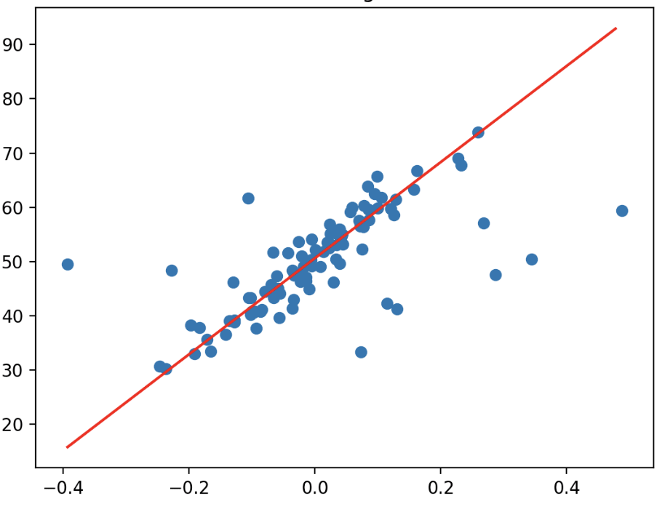
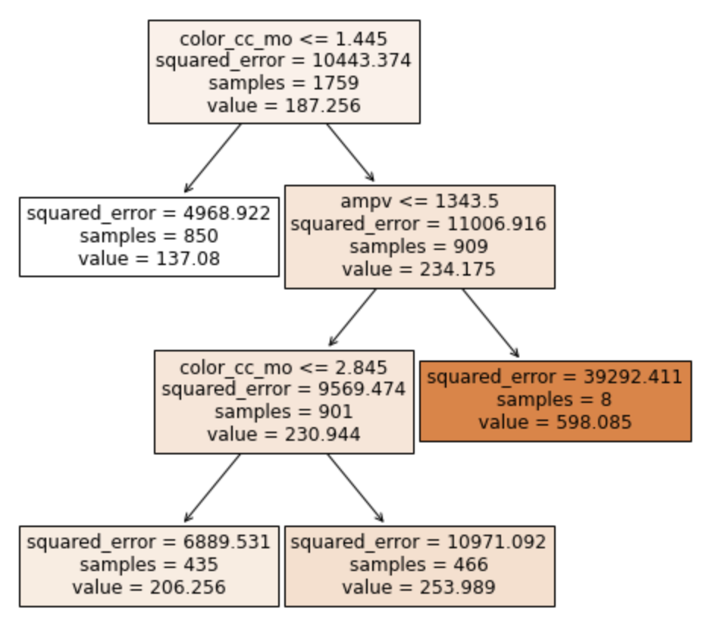
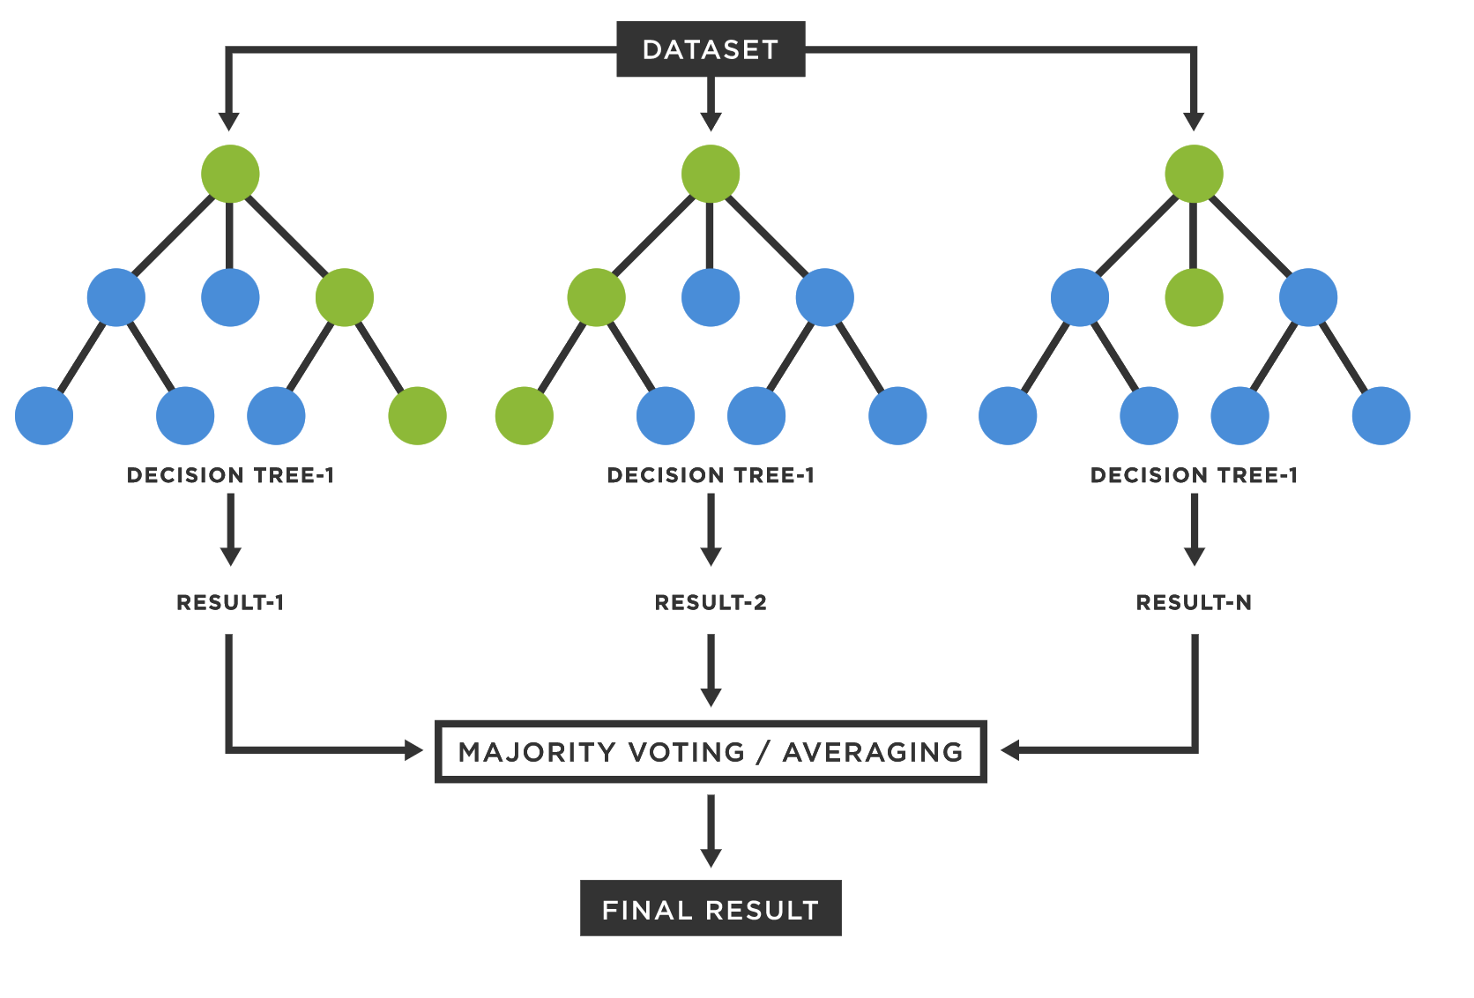
Build Segmentation Algorithm to Find the Most Profitable Customers
Model Development
Segmentation Factors
Key Findings
User Segmentation (K-Means)
Usage
Find incrementals in
Monthly consumption of color ink and pages positive relates to product price
Avg color ink used per month
Avg pages printed per month
#1:
‘Home’ (Self-employed) instead of ‘Office’
#2:
High purchasing propensity in ‘PC’ or ‘Laptop’
#3:
Further collaboration with companies that sell Laptop/PC devices but not printers
Regression
(e.g. Lasso, Ridge)
Demographics
Self-employed customers (esp. Administration/Managerial, Homemaker) prefer higher price vs. Office customers
Occupation
Household income
Decision Tree
Psychographics
Positive relations between price and:
Propensity of PC/Laptop
Propensity of Smaller format printers
Purchasing propensity (PP) of PC/Laptop/Competitors
Printer Type
Random Forests
Notes:
The first question is to find the most profitable customers, we use avg. price per user as predictor.
Then, we trained 6 different ways (incl. simple linear, lasso, ridge regression, decision tree and random forests) to find the significant variables.
After comparison, we defined our key metrics that are considered in user segmentation. The metric consists of 3 parts: Usage, demographics and pyschographics.
Usage: Avg. color ink used and pages printed per month
Demographics: Occupation, Household Income
Psychographics: Purchasing propensity of PC/Laptop/Competitors; and towards different printer types
=> With these key segmentation drivers, we did user segmentation using K-Means. Here are some findings with suggestions correspondingly:
Monthly consumption of color ink and pages positive relates to the purchased product price. The higher usage of color ink and papers, the more likely the customer would choose a higher price tier;
As for Occupation, self-employed or ‘at Home’ occupations (like self-employed administration/managerial, homemakers) have larger positive correlations with product prices, compared to other ‘office’ occupation types;
=> Call-for-actions: the company might grow business and find incrementals in developing ‘Home’ customers (vs. Office customers) as these individual at home or self-employed customers are more positively related to a higher price tier.
Some positive relationships between product price and purchasing propensity of PC/Laptop, and smaller format printers.
=> That is, customers who have propensities in PC or Laptop, might be willing to pick a higher-priced product vs those do not have purchasing propensity;
=> Especially for those who have propensity in PC Lenovo or Acer, because Lenovo or Acer these companies do not have printer business, customers might purchase HP printers instead. Thus, the HP company might build further collaboration with companies that sell Laptop/PC devices but not printers.

Slide 9
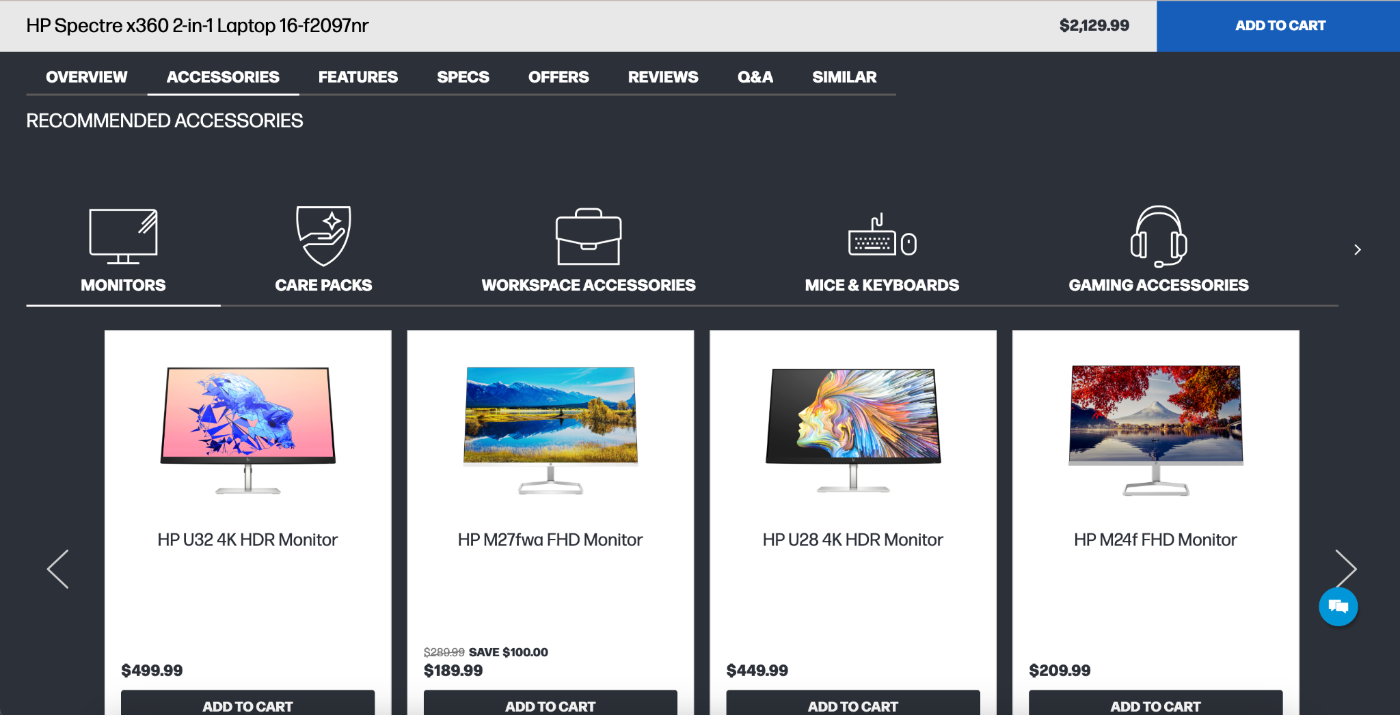
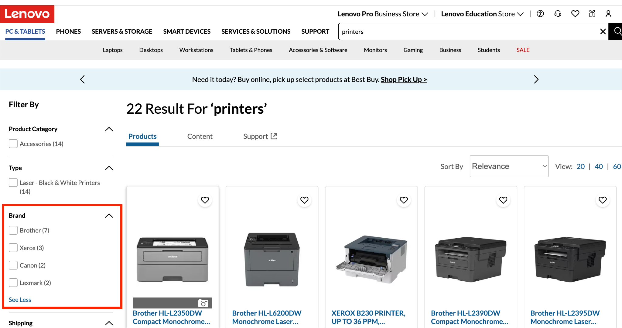
Interventions
Target ‘Home’ customers and promote ‘Small business and home office’ printing solutions
Promote bundle deals with laptops and desktop computers
Find complementary marketing opportunities with companies without printer businesses
No printer information!
No HP in printer brands!
Notes:
Based on the findings, here are some specific interventions that the company could implement:
1） Home office printing solutions: identified ‘Home’ customers, offer products and services that satisfy home-office printing needs, provide customization if possible;
2) Promote bundle deals with laptops and desktop computers: The company could promote printers on laptop or PC item pages.
Current situation: there is no printer logo or entrance or any related information on the first page of the laptop/PC item page. The users can only see related or suggested printers when they click to switch to the second page using the button, then the printers related information will be displayed. However, lots of customers might not find it and the company will loss potential revenues.
3） Find complementary marketing opportunities with companies without printer businesses like Lenovo: We search keyword ‘Printer’ on Lenovo website, although HP printer is compatible with Lenovo computers, but the search results show NO HP brand at all but other competitors like Canon or Brothers.

Slide 10
How to predict the repurchase propensity?
Segment customers with price
Random Forest Model prediction
Target high propensity customers
Under 100
Key influencers:
days
ave_cc_mo
Blk_cc_mo
Prediction accuracy: 94.4%
Creating buckets with product price
With the prediction models, we can:
Key influencers:
days
ave_cc_mo
color_cc_mo
Prediction accuracy: 92.4%
Target customers with high propensity of converging.
Monitor the change of propensity to improve customer journey.
Predict future revenue and make better use of assets.
Assumptions:
“Customers that buy different price printers share different characteristics.”
100 - 300
Key influencers:
days
ave_cc_mo
ampv
Prediction accuracy: 89.9%
300 - 500
Key influencers:
ampv
ave_cc_mo
color_cc_mo
Prediction accuracy: 86.9%
Over 500
Notes:
To accurately predict repurchase propensity, we separate the customers into 4 different groups in regard of the customers’ corresponding product purchase prices. This is base on the assumption that different tier of printers provide different services, and customer that requires different services generally concern about different things and have different characteristics.
Base on these 4 groups of customers, we use Random Forest model to make predictions on repurchase propensity. As we can see from the chart that the importance of customer features are different from group to group.
With this information, we can monitor the change in propensity of customers within each group, we’ll be able to
Target customers with high propensity of repurchase with customized ads or discounts, making campaigns both efficient and economical.
Monitor the change of repurchase propensity of the customers, with the model we build, we’ll be able to trace the change in repurchase propensity over time, by comparing the feature values, we’ll be able to identify what can be the driving factors of the change and make corresponding adjustments.
We’ll also be able to predict certain amount of revenue from repurchase behavior, this can help HP make better prediction of the future cash flow and make the most ideal asset arrangements.

Slide 11
Interventions: Differentiation marketing strategy based on RF feature importance
Product Price Buckets
Under 100
100 - 300
300 - 500
Over 500
Top 5 Features
ampv
ave_cc_mo
ampv
blk_cc_mo
ave_cc_mo
color_cc_mo
blk_cc_mo
color_cc_mo
blk_cc_mo
days
days
ave_cc_mo
color_cc_mo
ampv
ave_cc_mo
subscr_length
days
blk_cc_mo
color_cc_mo
ampv
Notes:
To accurately predict repurchase propensity, we separate the customers into four different groups based on their corresponding product purchase prices. This is based on the assumption that different tiers of printers provide different services, and customers who require different services generally have different concerns and characteristics.
Based on these four groups of customers, we use a Random Forest model to make predictions on repurchase propensity. As we can see from the chart, the importance of customer features differs from group to group.
With this information, we can monitor the change in propensity of customers within each group. We will be able to target customers with a high propensity of repurchase with customized ads or discounts, making campaigns both efficient and economical. We can also monitor the change in repurchase propensity of customers over time with the model we build. By comparing the feature values, we'll be able to identify the driving factors of the change and make corresponding adjustments.
Additionally, we'll be able to predict a certain amount of revenue from repurchase behavior. This can help HP make better predictions of future cash flow and make the most ideal asset arrangements.

Slide 12
Revenue-driven Recommendations Summary
Convert to Higher Price Tiers
(User Segmentation)
Improve Repurchase Propensity
(Prediction)
Increase Subscription Rate
(Long-term Strategy)
Research Sources:
Linear/Lasso/Ridge Regression
Decision tree
Random forest
K-Means
Logistic Regression
Random Forest
HP Annual report
2022 10K Report
HP Instant Ink
Segmentation driver matrix
Suggested customer groups
3 Key interventions
Identified features importance
Upgrade promotion of HP+ compatible product
Monitor customer propensity
Marketing campaign on Instant Ink subscription
Grow integrated HP services ecosystem (II, HP+, MPS)
Larger Basket Size
Higher Purchase Frequency
Stronger Customer Stickiness
Notes:
User Segmentation
Restructure recommended accessories website section to recommend printers to PC/laptop purchasers
One of our findings was that people who are likely to purchase a laptop/PC are also likely to buy printers.
Currently on HP’s website, printer accessories are “hidden” in the second page of the horitional view table. It’s listed behind other accessories like headphones, keyboards, etc.
Printers should be prominently displayed as recommended products on laptop/PC item pages, advertising as Buy it With: A (laptop/PC) + B (printer).
Increase product exposure in Partnership and Distribution network
Make HP products more visible in HP’s vast partnering retailer network including Amazon, Walmart, BestBuy, Staples, and Office Depot.
Bidding for prioritize display. List printer products on partnering firms that sell personal systems but don’t have their own printer products.
Propensity
Target customers, across four product price range, who are identified to be likely re-purchasers based on their value of their corresponding values in selected important features
Leverage customer groups to target high propensity customer bases for product upgrades
Target Home use customers with upgraded product line-ups
Subscription (Strategy)
Instant Ink subscription
Supplies (including ink and paper) contribute over 60% of net revenue in the Printing business area. However, less than half of buyers subscribe to Instant Ink, which is a monthly ink delivery subscription service.
Integrated service ecosystem
To maintain a loyal customer base, companies not only need good hardware, which HP already rolls out, they also need high-quality, integrated software that fills the gap in customer’s post-purchase experience.
HP has existing services like Instant Ink, HP+, and Managed Print Services (MPS). Each service provides benefits to customers, but there are rooms to improve customer usage of these services. A good way to do so is making sure they are well integrated so that their effects are echoed and reinforced.

Slide 13

We appreciate the opportunity to analyze HP’s rich dataset and learn amazing Google Looker software!
Team: Beauty and the Beasts

Slide 14
Appendix

Slide 15
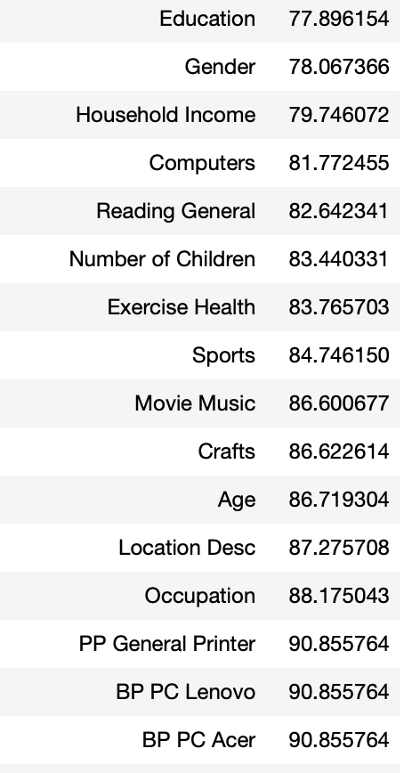
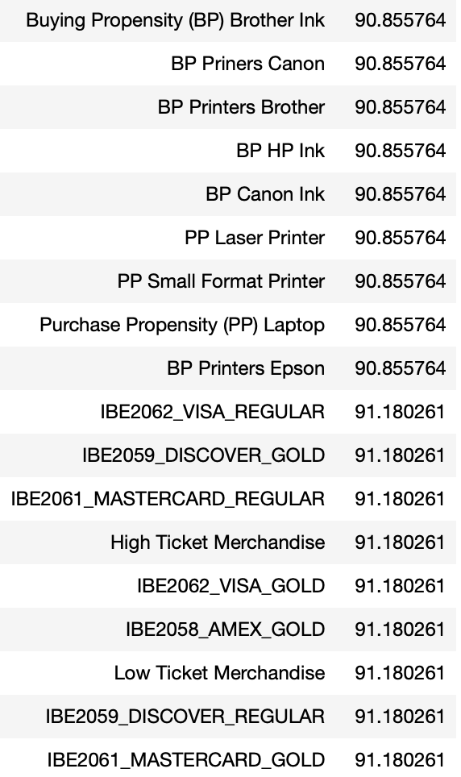
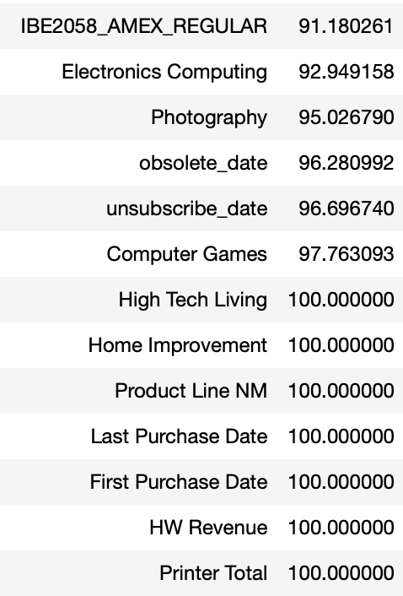
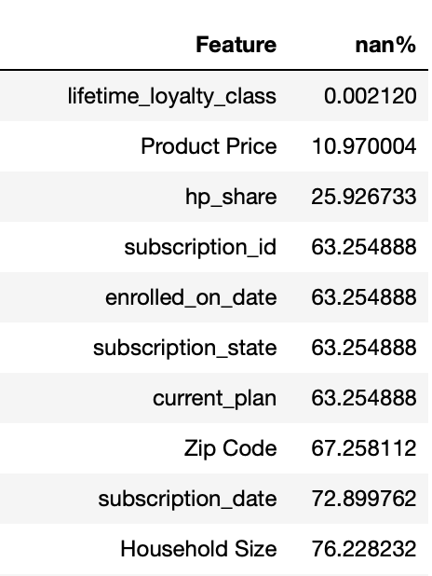
Appendix - Data cleaning
Original Shape : [2169826 , 75]
Check for empty value

Slide 16
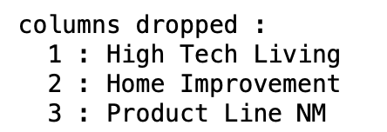
Appendix - Data cleaning
set cut off benchmark
-> Remove those 100% NaN values

Slide 17
Appendix - Data cleaning
First level cleaning:
Keep only users that have propensity scores
subscription state:
if subscription is na, we fill "unknow"
current plan:
if current plan is na, we fill "no plan"
create new column: [subscription_length] with column [obsolete_date] and column [enrolled_on_date] and drop other related columns:
enrolled_on_date
subscription_date
unsubscribe_date
obsolete_date
supply_selectability_number
subscription_id:
convert to binomial measure, 1 if has id, else 0
New shape: [198414, 64]

Slide 18
Appendix - Data cleaning
Second level filter
Drop all customers without lifetime_loyalty_class:
only 0.002016% missing
Fill "Product Price":
For those product that we've seen before, and have prices, we use average the price we seen before and parse it into those don't have value.
Fill with median for those products we've never seen before.

Slide 19
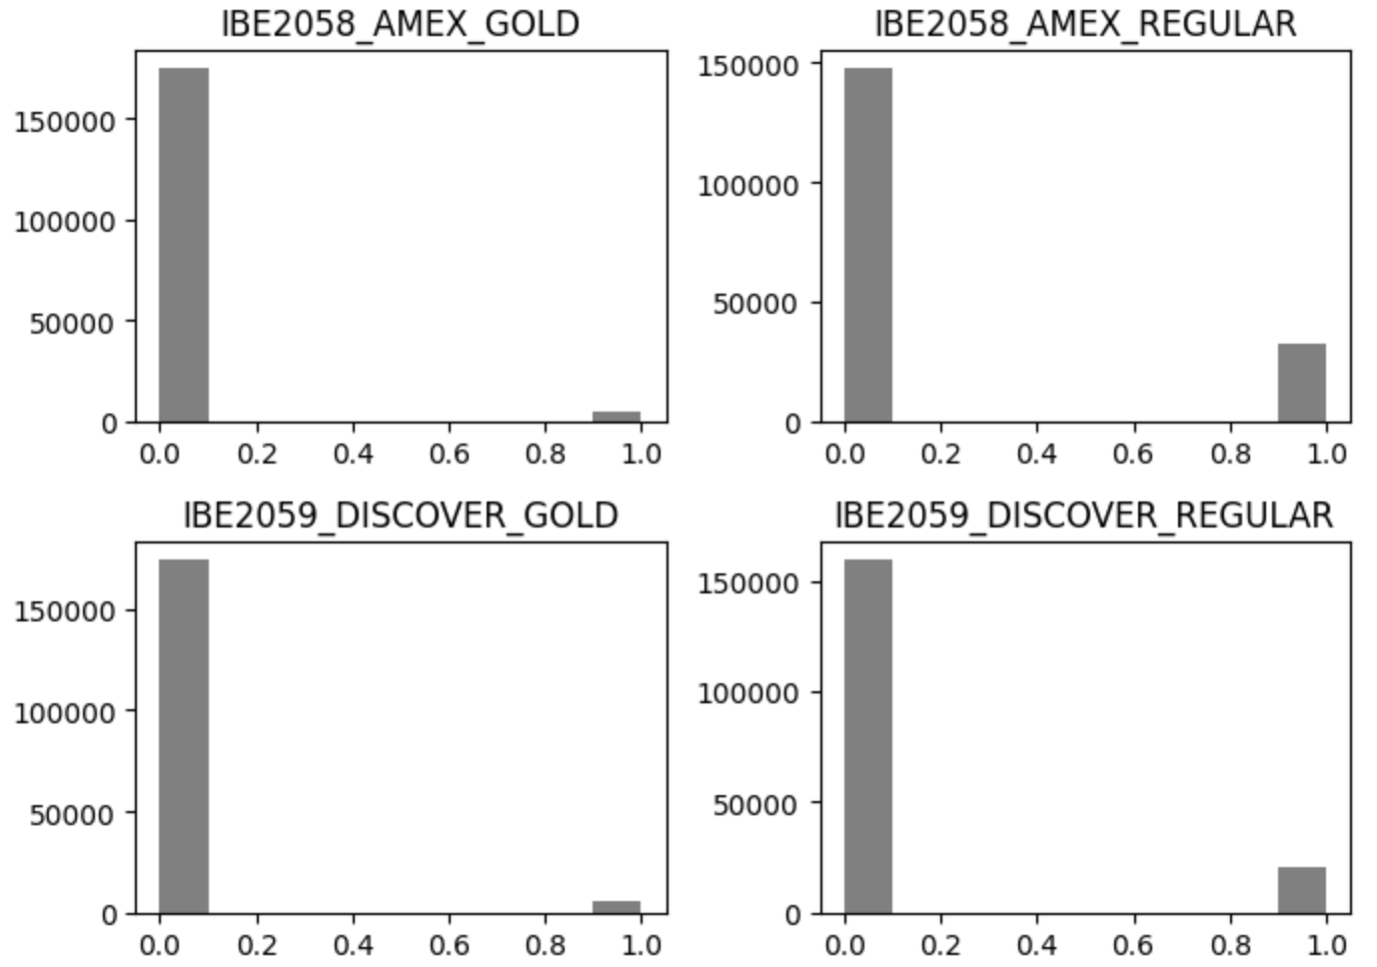
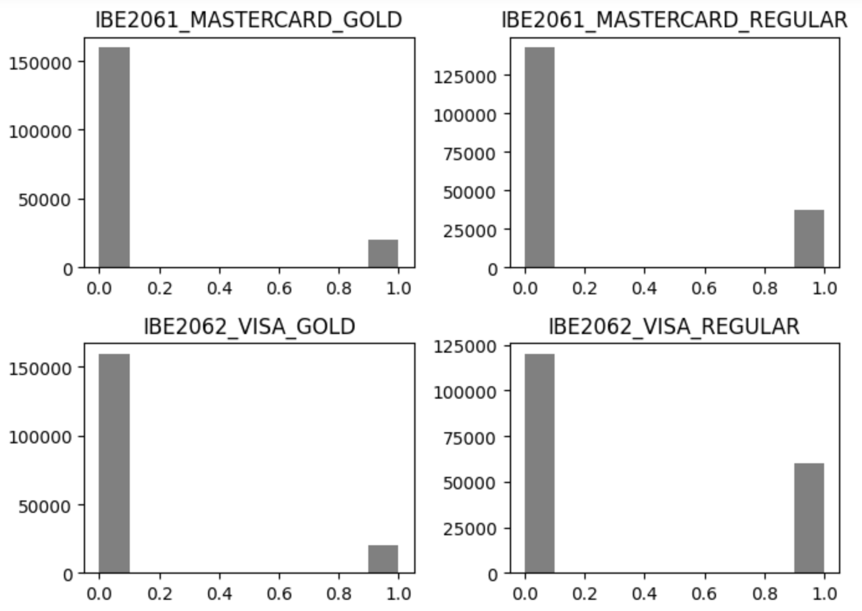
Appendix - Data cleaning
3. Credit card related:
drop all na values

Slide 20
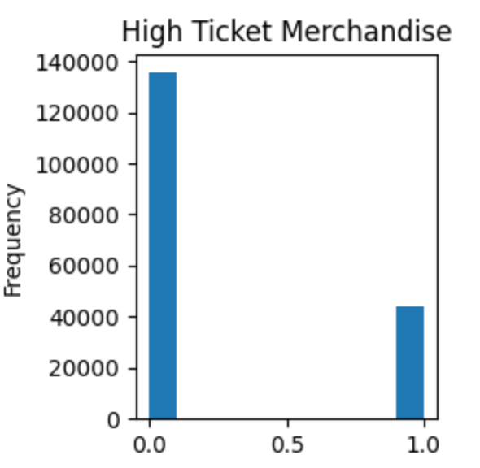
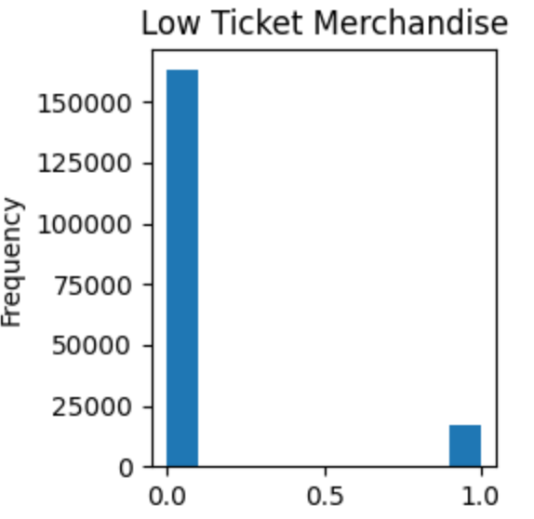
Appendix - Data cleaning
4. High or Low ticket merchandise:
drop all na values

Slide 21
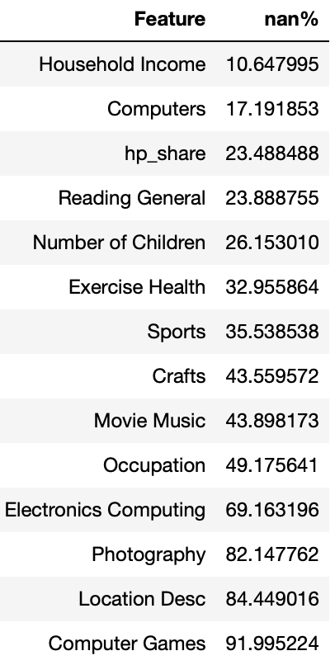
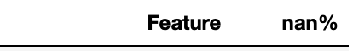
Appendix - Data cleaning
5. Drop age:
completely zero
New shape: [178381, 62]

Slide 22
Appendix - Data cleaning
Third level filter
For Household income:
drop A, B, C, D
fill with median
Drop Location Desc:
information hard to interpret
For rest of the features, we fill with 0
Final shape : [115384 , 65]

Slide 23
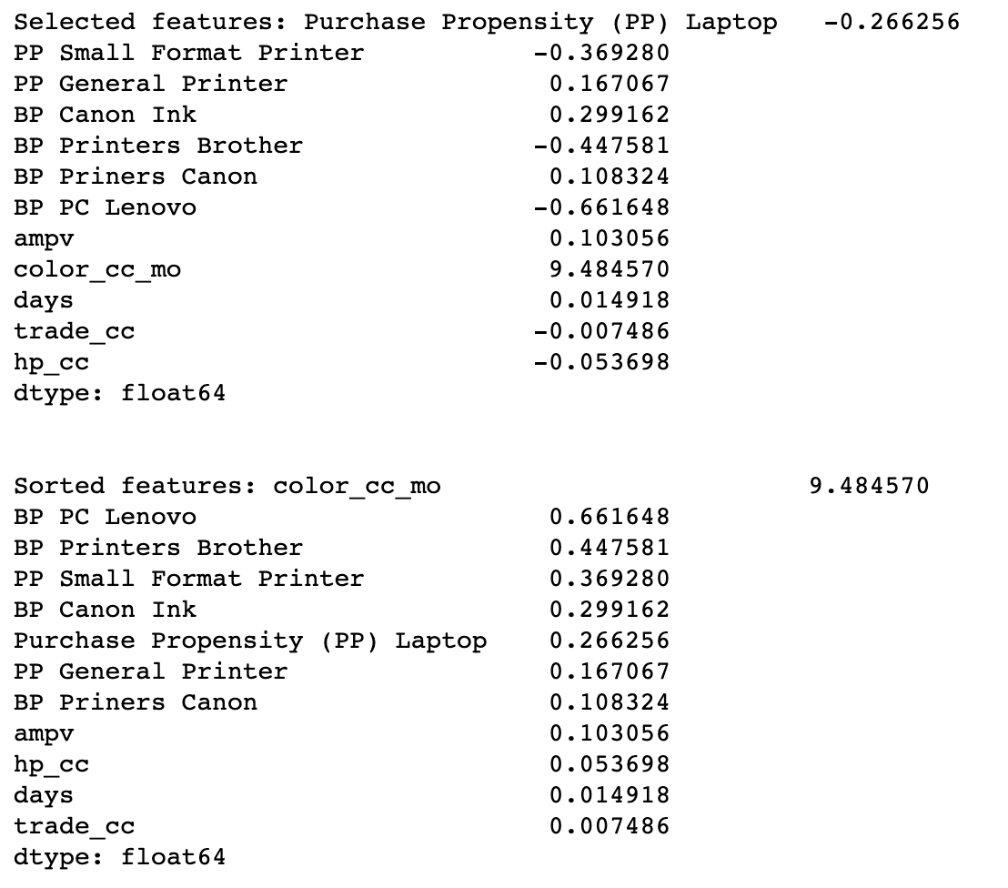
Appendix - Customer Segmentation, Lasso
Lasso Output:

Slide 24
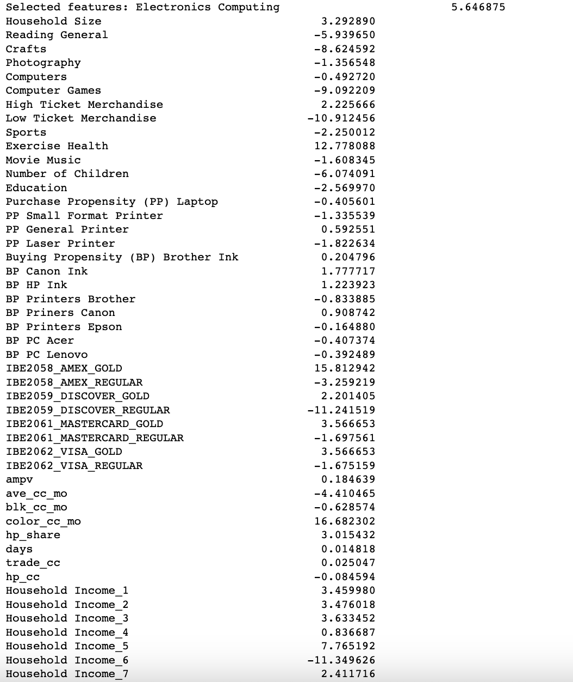
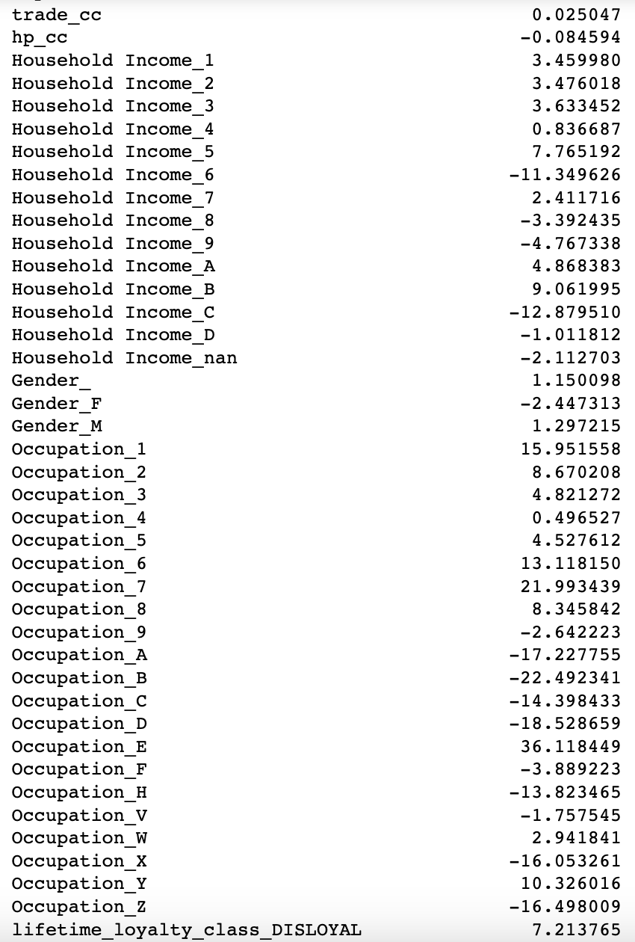
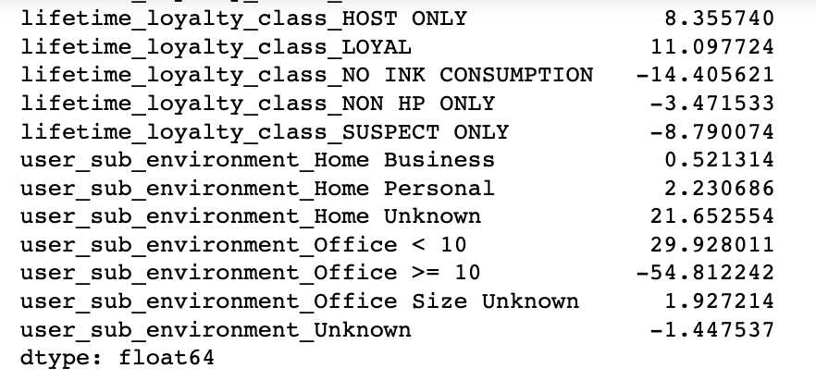
Appendix - Customer Segmentation, Ridge
Ridge Output:

Slide 25
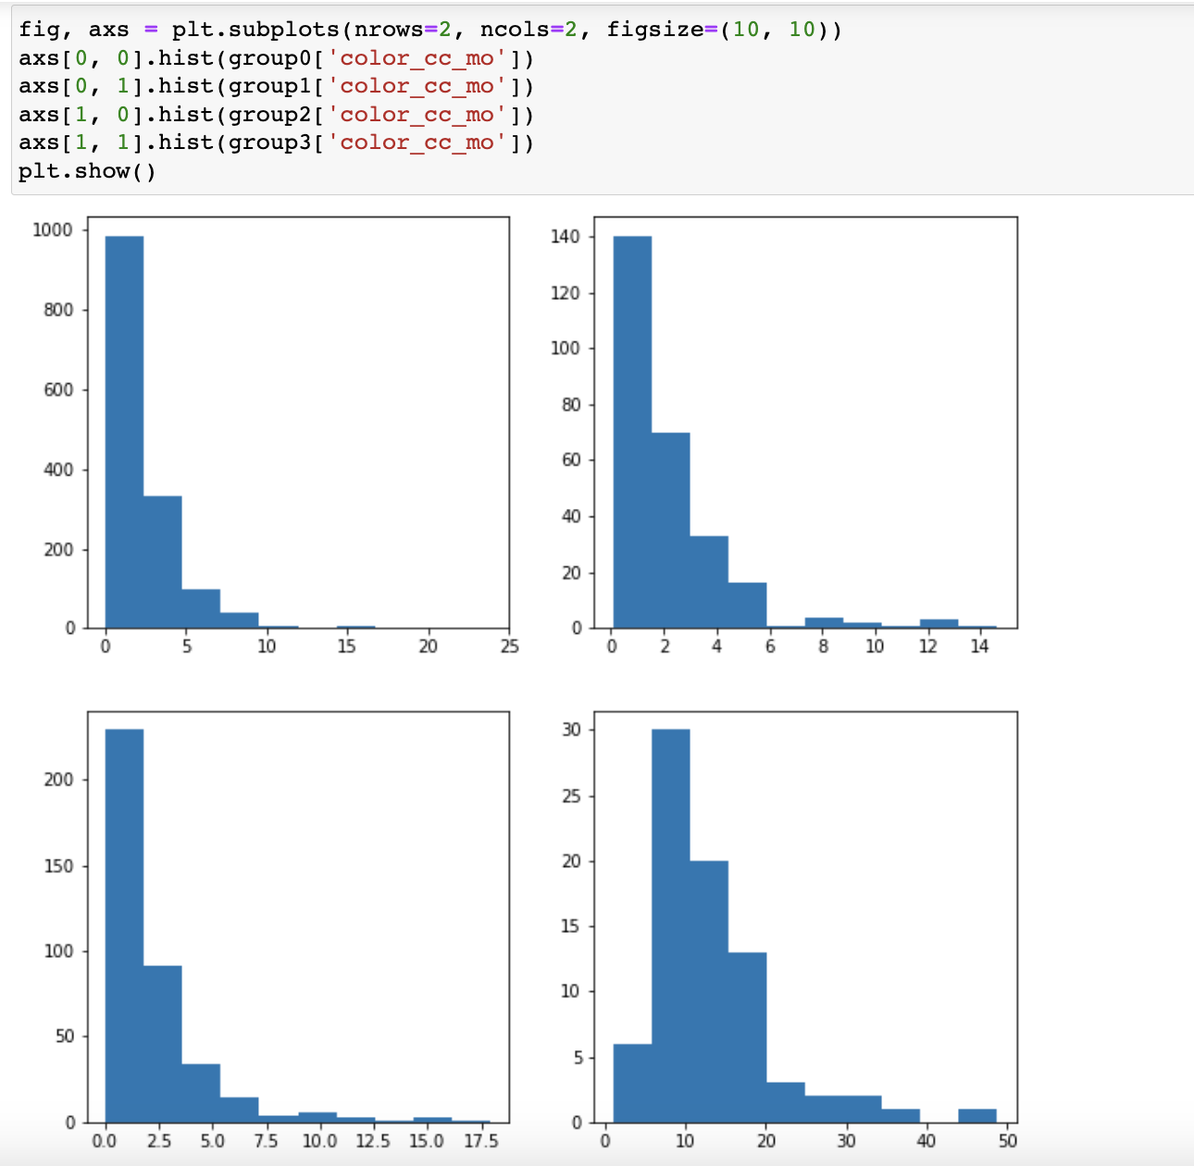
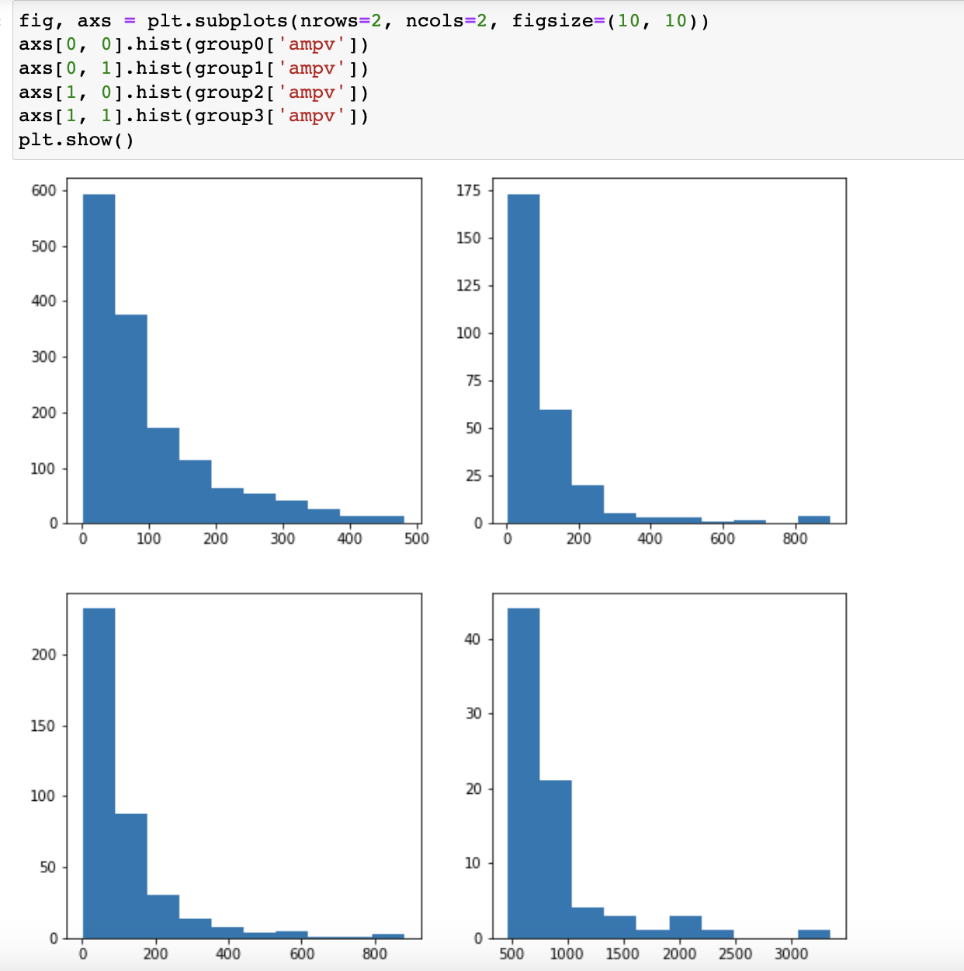
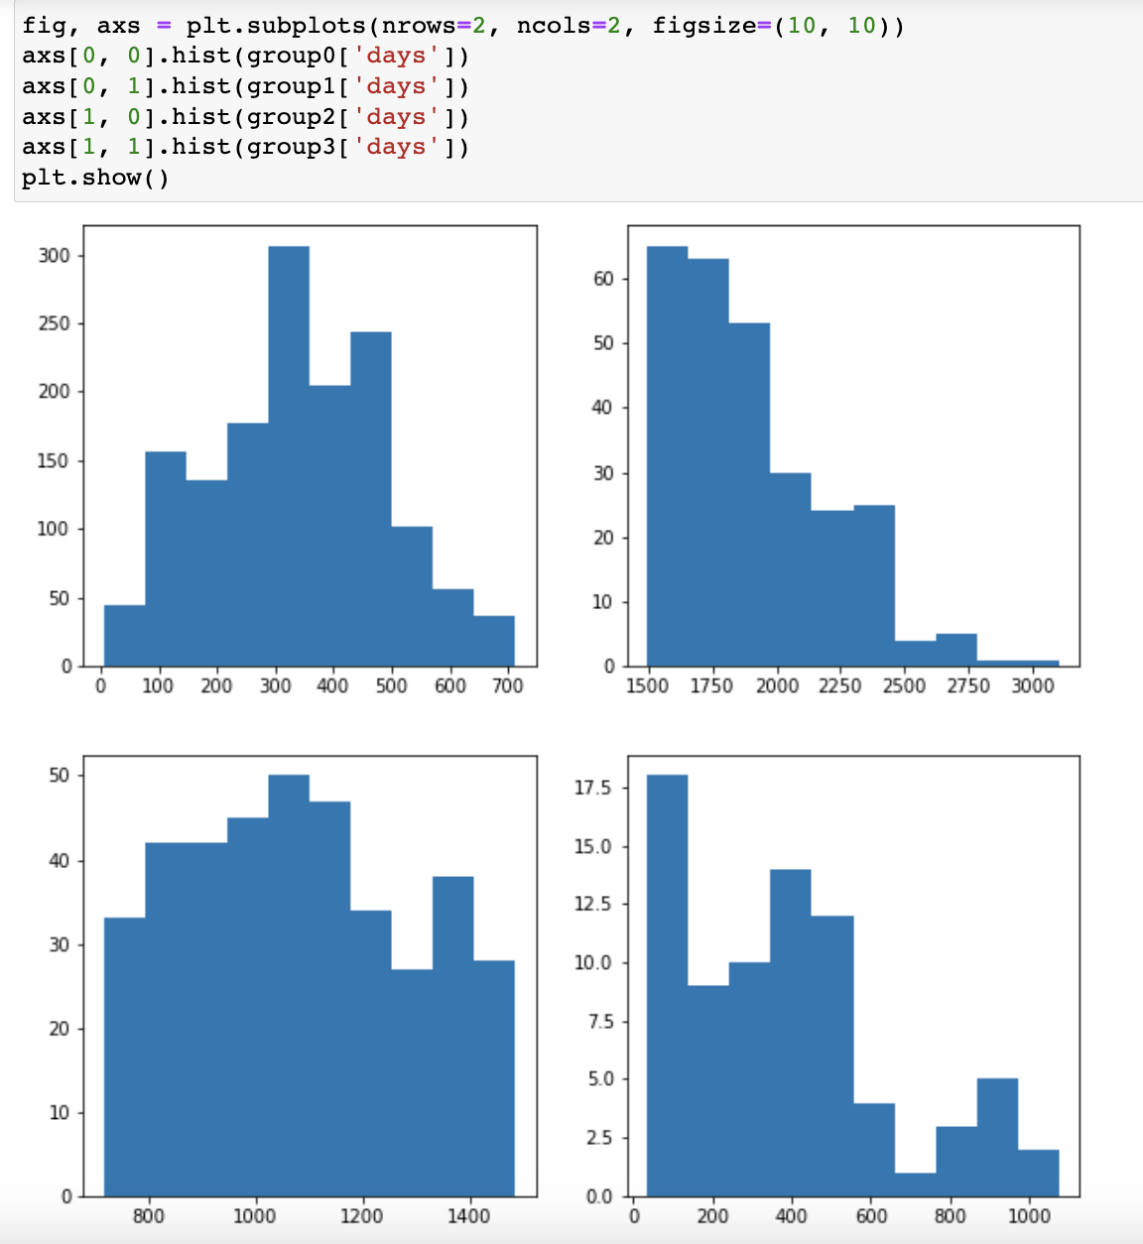
Appendix - Customer Segmentation, K-Means
K-Means Customer Segmentation:

Slide 26
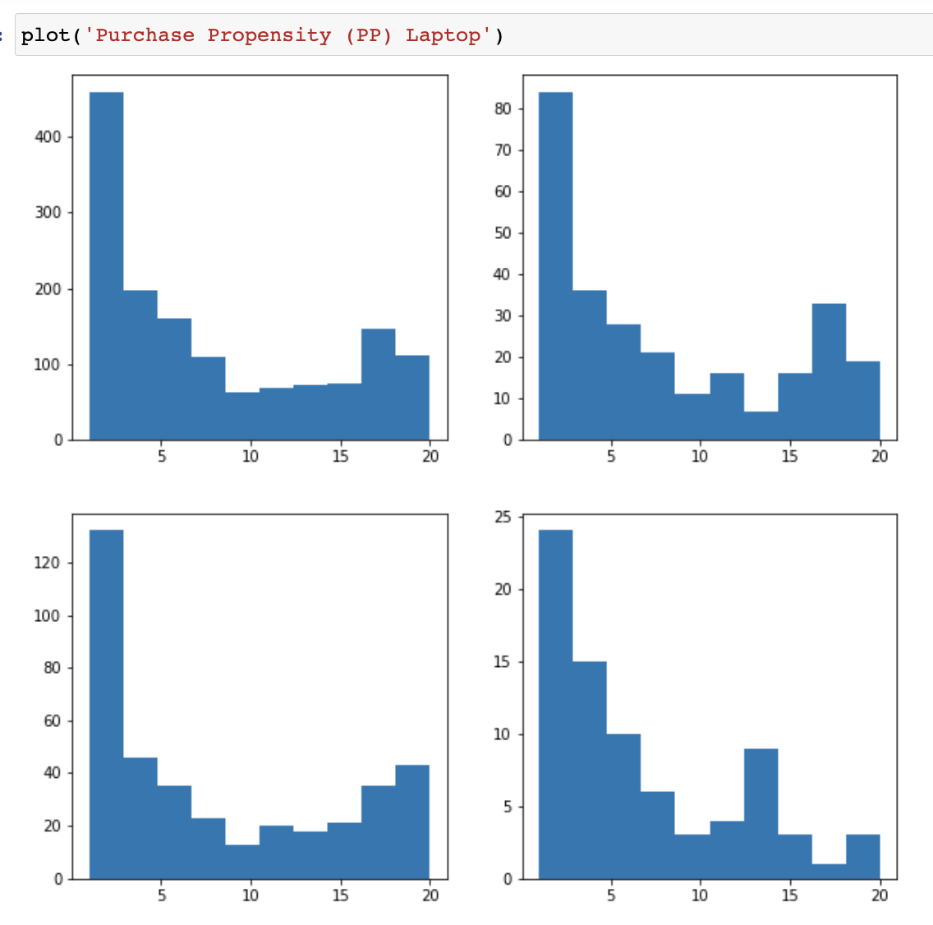
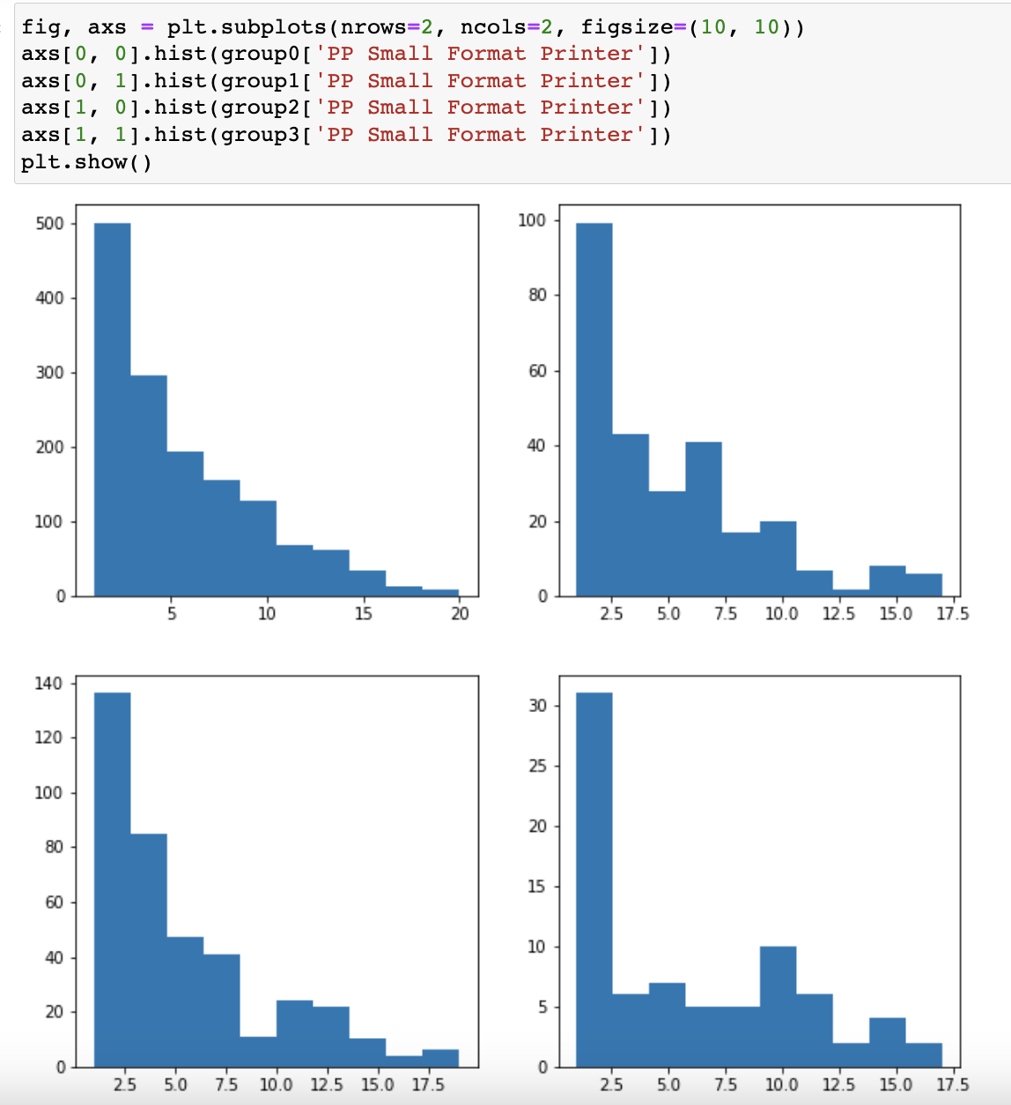
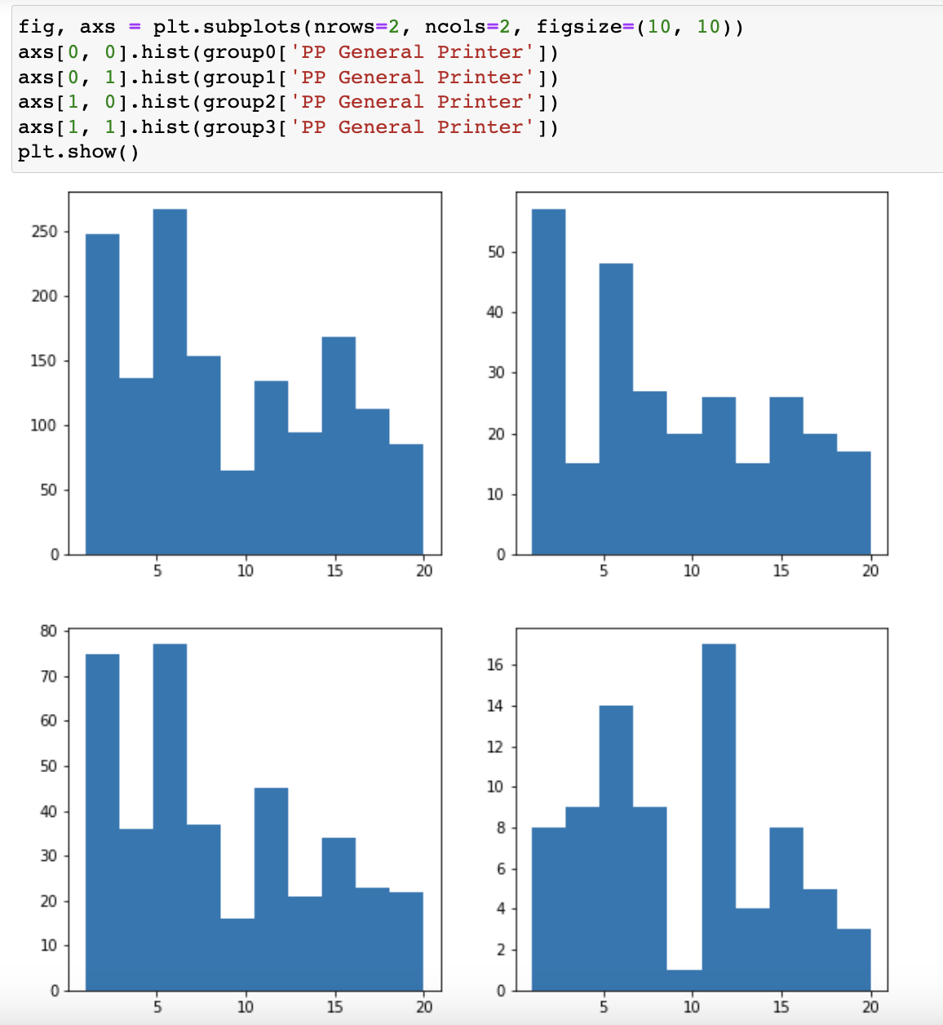
Appendix - Customer Segmentation, K-Means
K-Means Customer Segmentation:

Slide 27
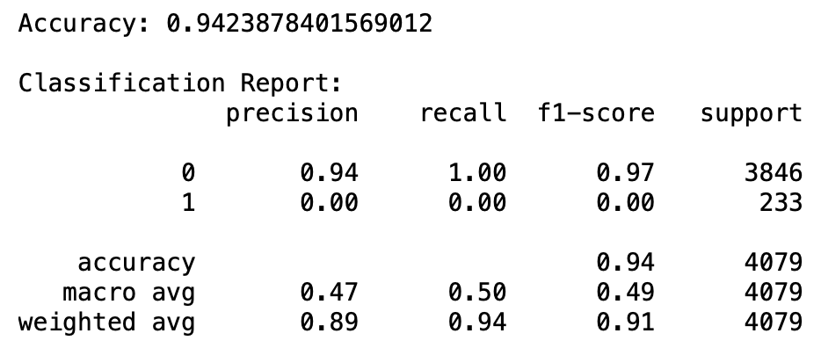
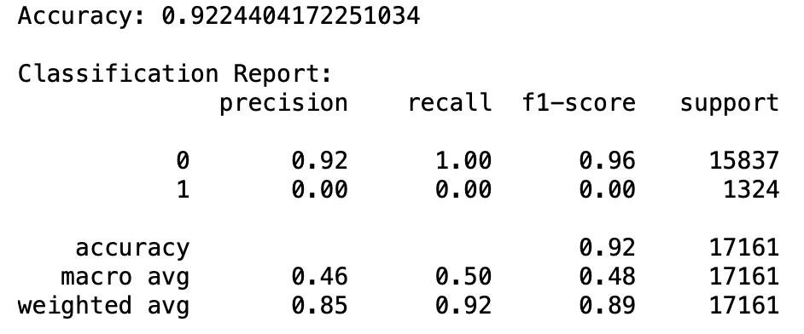
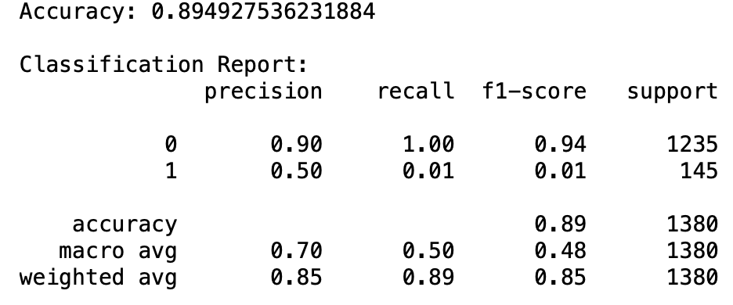
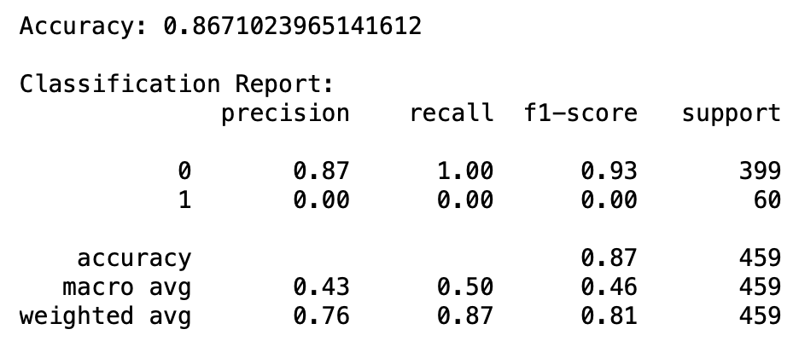
Appendix - Repurchase (logic)
Group A (< $100)
Group B ( $100 ~ $300)
Group C ( $300 ~ $500)
Group D (> $500)

Slide 28
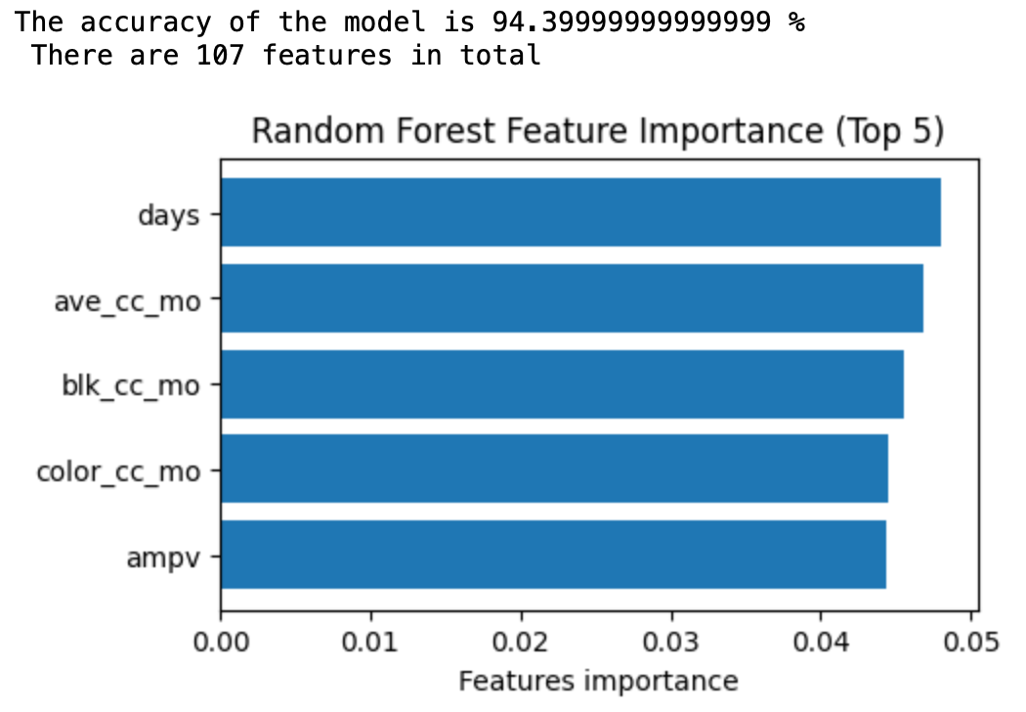
Appendix - Repurchase (RF)
Group A (< $100)

Slide 29
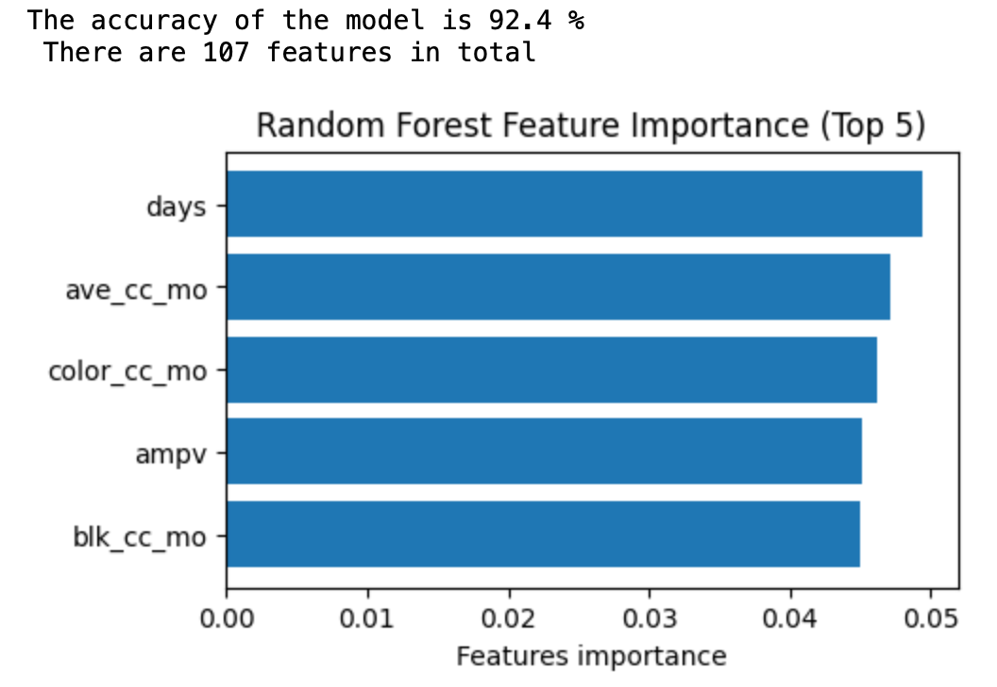
Appendix - Repurchase (RF)
Group B ( $100 ~ $300)

Slide 30
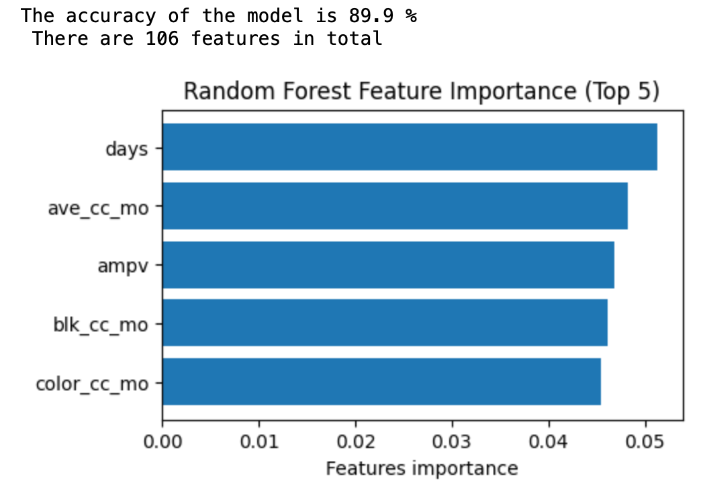
Appendix - Repurchase (RF)
Group C ( $300 ~ $500)

Slide 31
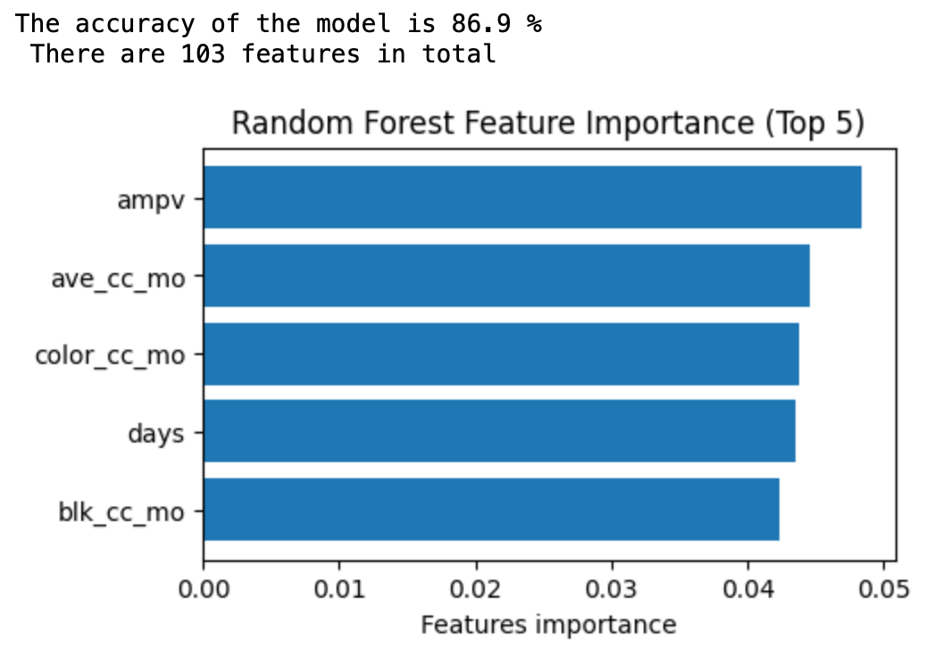
Appendix - Repurchase (RF)
Group D (> $500)

Slide 32
Appendix - Data Descriptions
Basic customer and product info
Customer demographics
Customer interest and behavioral info
Customer product usage info
2,169,286 rows
75 columns
Notes:
We were provided with a massive de-identified dataset from Z by HP. It is a partial dataset to HP’s first-party customer database. The dataset contains 2,169,286 rows of product-level data that can be aggregated to customer level. It has 75 fields including
basic customer and product info (e.g. customer id, product serial number)
customer demographics info (e.g. age, gender)
customer interest and behavioral info (e.g. customer purchasing propensity of various products)
HP product usage info (e.g. total ink used, average monthly pages printed)
With its size, the dataset also comes with necessary preprocessing needs. Specifically, we applied several techniques to address missing values in the data. We also made a few necessary assumptions to progress our analysis.

Slide 33
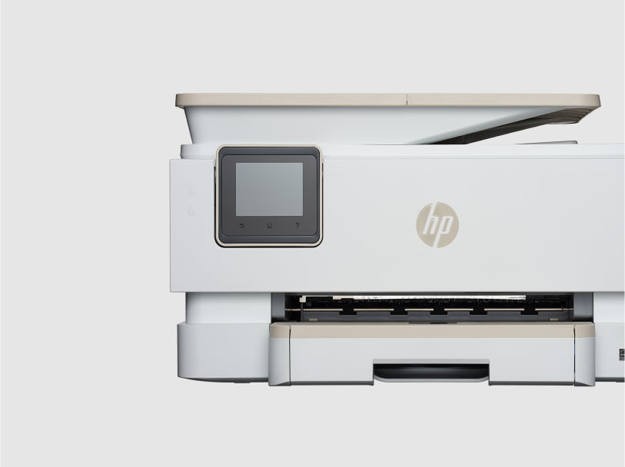
Appendix: Printer Products
DeskJet
OfficeJet
2755e, 4155e, 3755
8025e, 8035e, 9015e, 9025e
ENVY
LaserJet
6055e, 6455e, Inspire 7255e
3001dw, M255DW, M406dn
Notes:
HP printers are categorized into various product families such as DeskJet, ENVY, OfficeJet, and LaserJet. Each family has substantial product depth, usually containing multiple product models.

Slide 34
Appendix: Net Revenue - Printing (2022 10k)
 | 2022 | 2021 | 2020
Supplies | $11,761 (62%) | $12,632 (63%) | $11,586 (66%)
Commercial | $4,225 (23%) | $4,209 (21%) | $3,539 (20%)
Consumer | $2,916 (15%) | $3,287 (16%) | $2,516 (14%)
Total Printing | $18,902 | $20,128 | $17641
https://s2.q4cdn.com/602190090/files/doc_financials/2022/ar/hp-fy2022-10-k.pdf

Slide 35
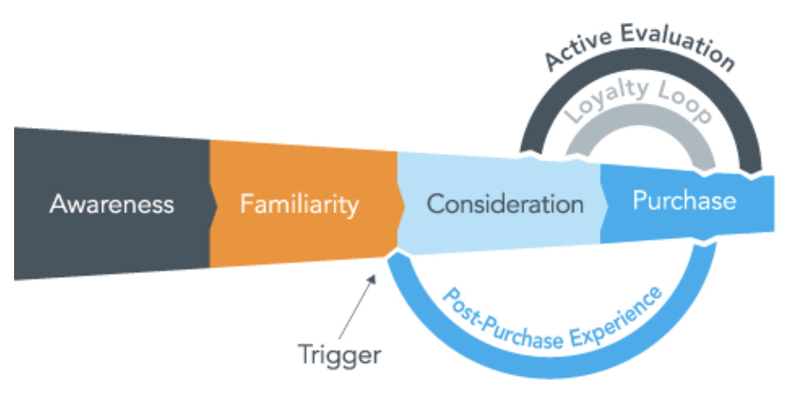
Appendix: Customer Purchase Journey
https://blog.sightly.com/sightlyinsights/full-funnel-solution

Slide 36
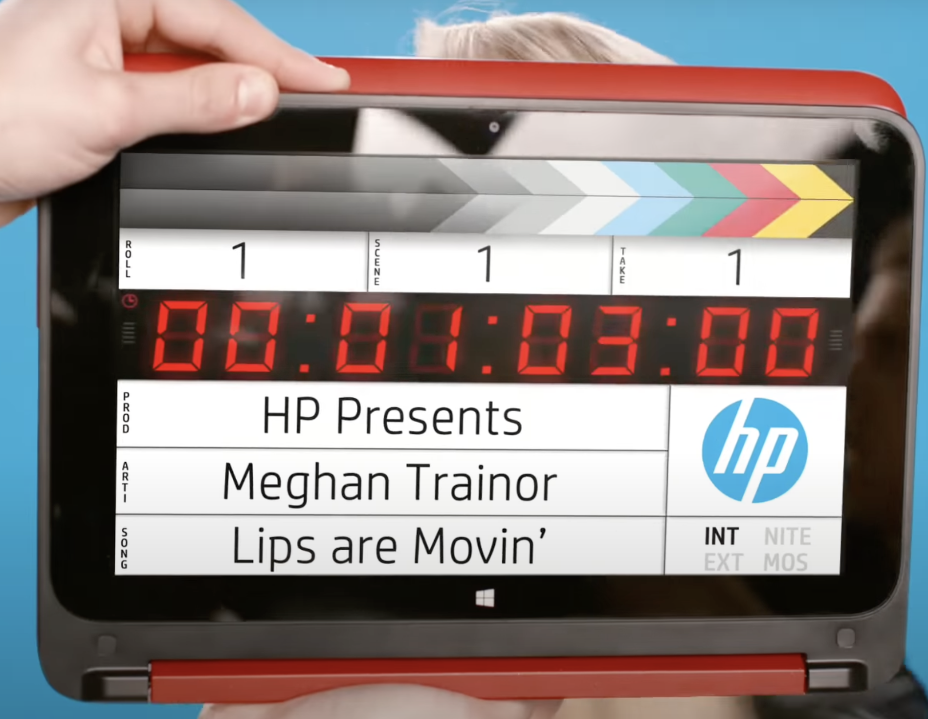

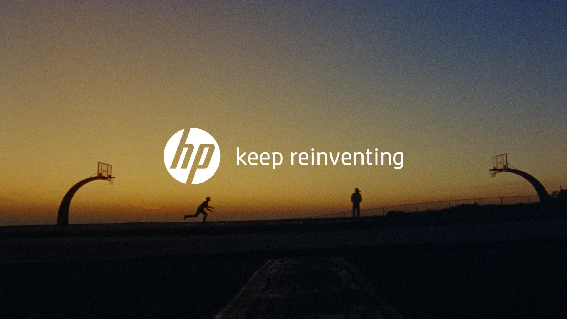
Appendix: Awareness & Familiarity
#BENDTHERULES
The Wolf Campaign
Keep Reinventing
Pavilion x360
Secure Printers
Brand Slogan
Content Marketing
Notes:
HP already does a pretty good job at content marketing (collab with celebrities to create authentic promotional content such as videos and music). These campaigns are usually costly. In the current economic state, HP might need to switch to more low cost marketing channels (also mentioned in HP’s 2022 10K report)

Slide 37
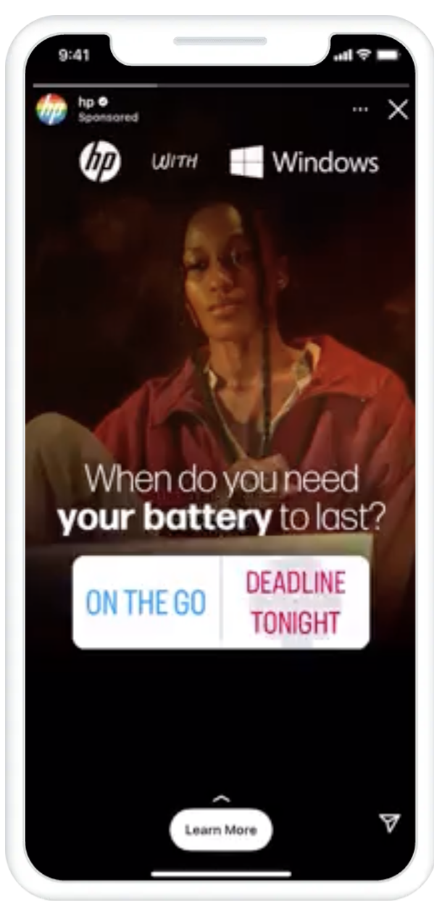
Appendix: Awareness & Familiarity
5.2M
4.7M
Chat Conversations
Likes and Comments
Click Through
Interactive Ads
Brand LIft
1.3M
1.1M
244k
Social Media Marketing
Notes:
HP has a solid follower base on many major platforms. They could pour more effort into promotional campaigns on their social media accounts to raise brand awareness and further grow their follower base.
Facebook: 4.68M followers
Twitter: 1.1M followers
Instagram: 1.3M followers
YouTube: 244k followers
LinkedIn: 5.2M followers
Recorded as a case study, HP ran ads on Instagram story. The campaign showed many highlighted features of social media marketing. including:
Chat history
Likes and comments
Click through rate
Interactive ads for engagement
Overall brand lift

